Slide 1
Today's agenda
Configuring Final Reminder Timing notification
Enable or disable Notifications for a class
Configuring Final Reminder Text
Firing adhoc class notification

Slide 2
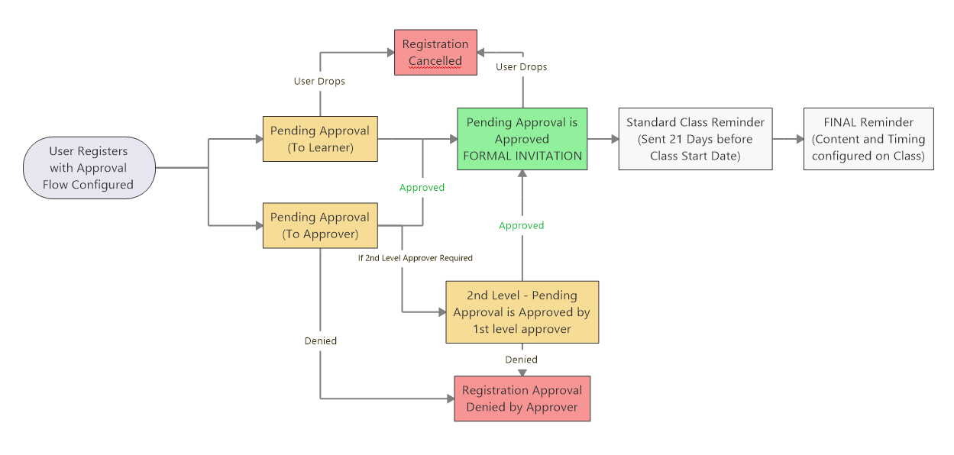
Instructor Led & Blended Approval Required Notification Flow

